Slide 1
INTRODUCTION TO BIG DATA ANALYTICS
CSA3004

Slide 2
Content
What is Big Data? Evolution of Big Data
Big data Challenges-Traditional versus big data approach
Structured, unstructured, semi-structured and quasi structured data.
Drivers for Big data- Five Vs
Big data applications.
Basics of Distributed File System
The Big Data Technology Landscape: No-SQL The Hadoop:

Slide 3
What is Big Data?
Big Data is a term used for a collection of data sets that are large and complex, which is difficult to store and process using available database management tools or traditional data processing applications.
The challenge includes capturing, curating, storing, searching, sharing, transferring, analyzing and visualization of this data.

Slide 4
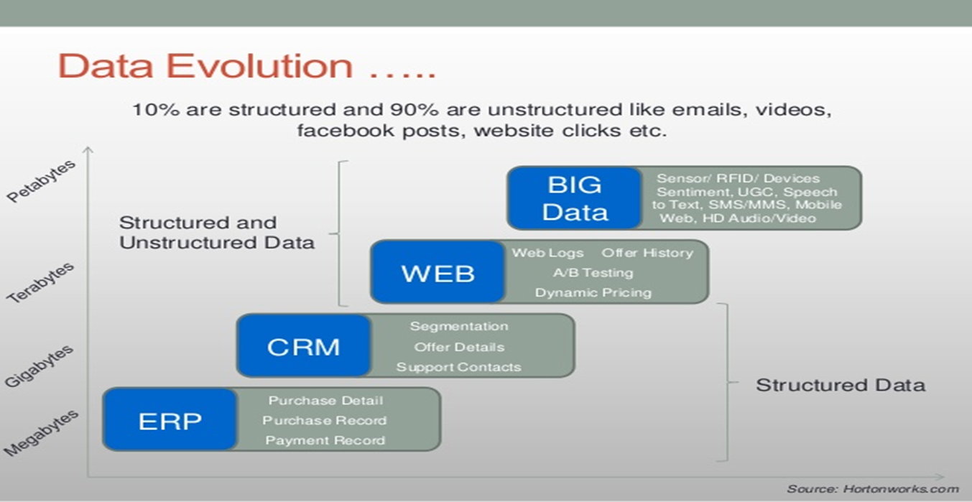
Evolution of Big Data

Slide 5
Big data Challenges-Traditional versus big data approach
SR.NO | TRADITIONAL DATA | BIG DATA
1 | Traditional data is generated in enterprise level. | Big data is generated in outside and enterprise level.
2 | Its volume ranges from Gigabytes to Terabytes. | Its volume ranges from Petabytes to Zettabytes or Exabytes.
3 | Traditional database system deals with structured data. | Big data system deals with structured, semi structured and unstructured data.
4 | Traditional data is generated per hour or per day or more. | But big data is generated more frequently mainly per seconds.
5 | Traditional data source is centralized and it is managed in centralized form. | Big data source is distributed and it is managed in distributed form.
6 | Data integration is very easy. | Data integration is very difficult.
7 | Normal system configuration is capable to process traditional data. | High system configuration is required to process big data.
8 | The size of the data is very small. | The size is more than the traditional data size.
9 | Traditional data base tools are required to perform any data base operation. | Special kind of data base tools are required to perform any data base operation.

Slide 6
SR.NO | TRADITIONAL DATA | BIG DATA
10 | Its data model is strict schema based and it is static. | Its data model is flat schema based and it is dynamic.
11 | Traditional data is stable and inter relationship. | Big data is not stable and unknown relationship.
12 | Traditional data is in manageable volume. | Big data is in huge volume which becomes unmanageable.
13 | It is easy to manage and manipulate the data. | It is difficult to manage and manipulate the data.
14 | Its data sources includes ERP transaction data, CRM transaction data, financial data, organizational data, web transaction data etc. | Its data sources includes social media, device data, sensor data, video, images, audio etc.

Slide 7
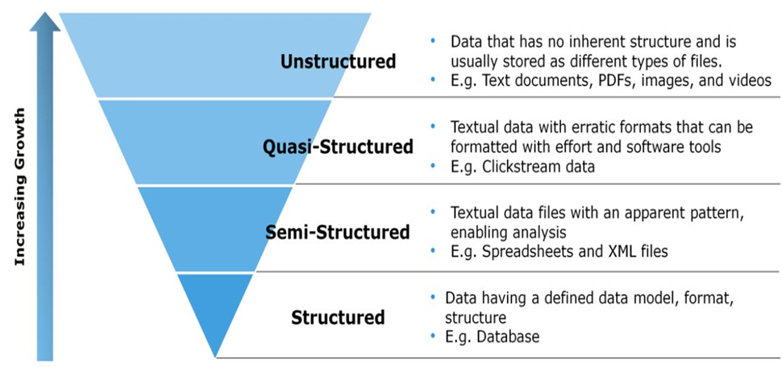
Types of Big Data
Unstructured
Quasi-Structured
Semi-Structured
Structured

Slide 8
Structured Data
Structured data is the data which conforms to a data model, has a well define structure, follows a consistent order and can be easily accessed and used by a person or a computer program.
Structured data is usually stored in well-defined schemas such as Databases, tabular with column and rows that clearly define its attributes.
SQL (Structured Query language) is often used to manage structured data stored in databases.
Characteristics:
Easily identifiable structure,
Rows and columns Example : Database,
Well organized so, Definition, Format and Meaning of data is explicitly known.
Data resides in fixed fields within a record or file
Easy to access and query,

Slide 9
Structured Data Cont…
Sources of Structured Data:
SQL Databases
Spreadsheets such as Excel
OLTP Systems
Online forms
Sensors such as GPS or RFID tags
Network and Web server logs
Medical devices
Advantages:
Easy to understand and use.
Consistency.
Efficient storage and retrieval.
Enhanced data security

Slide 10
Unstructured Data
Unstructured data is the data which does not conforms to a data model and has no easily identifiable structure such that it can not be used by a computer program easily.
Unstructured data is not organized in a pre-defined manner or does not have a pre-defined data model, thus it is not a good fit for a mainstream relational database.
Characteristics of Unstructured Data:
Data neither conforms to a data model nor has any structure.
Data can not be stored in the form of rows and columns as in Databases
Data does not follows any semantic or rules
Data lacks any particular format or sequence
Data has no easily identifiable structure
Due to lack of identifiable structure, it can not used by computer programs easily
Sources of Unstructured Data:
Web pages, Images (JPEG, GIF, PNG, etc.),videos,memos,Reports,Surveys

Slide 11
Semi Structured Data
Semi-structured data is a type of data that is not purely structured, but also not completely unstructured.
It contains some level of organization or structure, but does not conform to a rigid schema or data model, and may contain elements that are not easily categorized or classified.
Characteristics of semi-structured Data:
Data does not conform to a data model but has some structure.
Data can not be stored in the form of rows and columns as in Databases.
Similar entities are grouped together and organized in a hierarchy
Entities in the same group may or may not have the same attributes or properties
Does not contain sufficient metadata which makes automation and management of data difficult
Size and type of the same attributes in a group may differ.
Sources of semi-structured Data:
Emails,XMl,TCP/IP pckets etc.

Slide 12
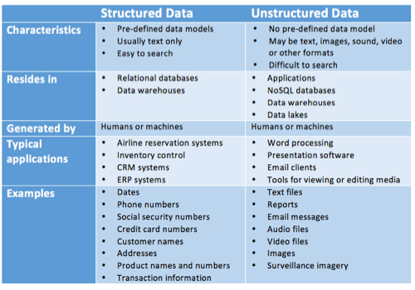

Slide 13
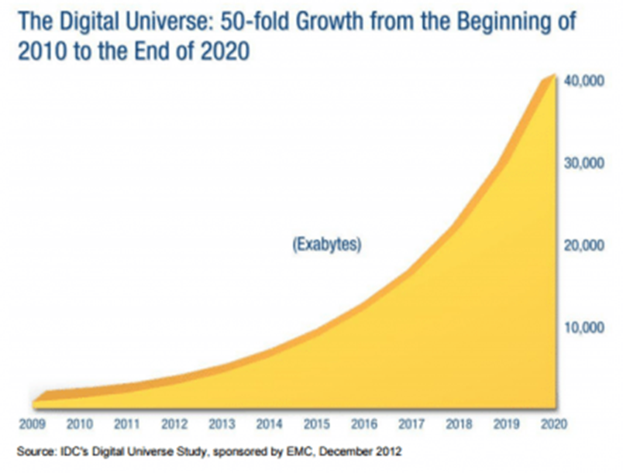
Characteristics of Big Data
The five characteristics that define Big Data are: Volume, Velocity, Variety, Veracity and Value.
VOLUME
Volume refers to the ‘amount of data’, which is growing day by day at a very fast pace.
The size of data generated by humans, machines and their interactions on social media itself is massive.
Researchers have predicted that 40 Zettabytes (40,000 Exabytes) will be generated by 2020, which is an increase of 300 times from 2005.

Slide 14

Characteristics of Big Data
VELOCITY
Velocity is defined as the pace at which different sources generate the data every day.
This flow of data is massive and continuous.
There are 1.03 billion Daily Active Users (Facebook DAU) on Mobile as of now, which is an increase of 22% year-over-year.
This shows how fast the number of users are growing on social media and how fast the data is getting generated daily.
If we are able to handle the velocity, we will be able to generate insights and take decisions based on real-time data.

Slide 15


VARIETY
As there are many sources which are contributing to Big Data, the type of data they are generating is different.
It can be structured, semi-structured or unstructured.
Hence, there is a variety of data which is getting generated every day.
Earlier, we used to get the data from excel and databases, now the data are coming in the form of images, audios, videos, sensor data etc. as shown in below image.
Hence, this variety of unstructured data creates problems in capturing, storage, mining and analyzing the data.

Slide 16

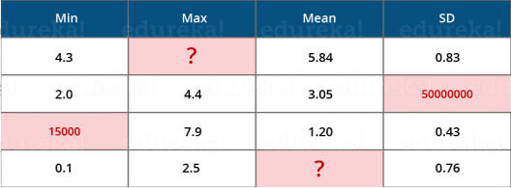
VERACITY
Veracity refers to the data in doubt or uncertainty of data available due to data inconsistency and incompleteness.
In the image below, you can see that few values are missing in the table. Also, a few values are hard to accept, for example – 15000 minimum value in the 3rd row, it is not possible.
This inconsistency and incompleteness is Veracity.
Data available can sometimes get messy and maybe difficult to trust.
With many forms of big data, quality and accuracy are difficult to control like Twitter posts with hashtags, abbreviations, typos and colloquial speech.
The volume is often the reason behind for the lack of quality and accuracy in the data.

Slide 17

VALUE
It is all well and good to have access to big data but unless we can turn it into value it is useless.
By turning it into value It means, Is it adding to the benefits of the organizations who are analyzing big data? Is the organization working on Big Data achieving high ROI (Return On Investment)?
Unless, it adds to their profits by working on Big Data, it is useless.

Slide 18
Applications of Big Data
Smarter Healthcare
-Making use of the petabytes of patient’s data, the organization can extract meaningful information and then build applications that can predict the patient’s deteriorating condition in advance.
Telecom
-Telecom sectors collects information, analyzes it and provide solutions to different problems.
- By using Big Data applications, telecom companies have been able to significantly reduce data packet loss, which occurs when networks are overloaded, and thus, providing a seamless connection to their customers.

Slide 19
Applications of Big Data
Retail
Retail has some of the tightest margins, and is one of the greatest beneficiaries of big data.
The beauty of using big data in retail is to understand consumer behavior.
Amazon’s recommendation engine provides suggestion based on the browsing history of the consumer.
Traffic control
Traffic congestion is a major challenge for many cities globally.
Effective use of data and sensors will be key to managing traffic better as cities become increasingly densely populated.

Slide 20
Applications of Big Data
Manufacturing
Analyzing big data in the manufacturing industry can reduce component defects, improve product quality, increase efficiency, and save time and money.
Search Quality
Every time we are extracting information from google, we are simultaneously generating data for it.
Google stores this data and uses it to improve its search quality.

Slide 21
The Big Data Technology Landscape: No-SQL(Not Only SQL)
No-SQL The term NoSQL was first coined by Carlo Strozzi in 1998 to name his light weight, open-source, non-relational database that did not expose the standard SQL interface.
A NoSQL originally referring to non SQL or non relational is a database that provides a mechanism for storage and retrieval of data.
This data is modeled in means other than the tabular relations used in relational databases.
NoSQL databases are used in real-time web applications and big data and their use are increasing over time.
NoSQL systems are also sometimes called Not only SQL to emphasize the fact that they may support SQL-like query languages.

Slide 22
The Big Data Technology Landscape: No-SQL(Not Only SQL)
A NoSQL database includes simplicity of design, simpler horizontal scaling to clusters of machines and finer control over availability.
The data structures used by NoSQL databases are different from those used by default in relational databases which makes some operations faster in NoSQL.
The suitability of a given NoSQL database depends on the problem it should solve.
Data structures used by NoSQL databases are sometimes also viewed as more flexible than relational database tables.

Slide 23
The Big Data Technology Landscape: No-SQL(Not Only SQL)
The concept of NoSQL databases became popular with Internet giants like Google, Facebook, Amazon, etc. who deal with huge volumes of data.
The system response time becomes slow when you use RDBMS for massive volumes of data.
To resolve this problem, we could “scale up” our systems by upgrading our existing hardware. This process is expensive.
The alternative for this issue is to distribute database load on multiple hosts whenever the load increases. This method is known as “scaling out.”

Slide 24
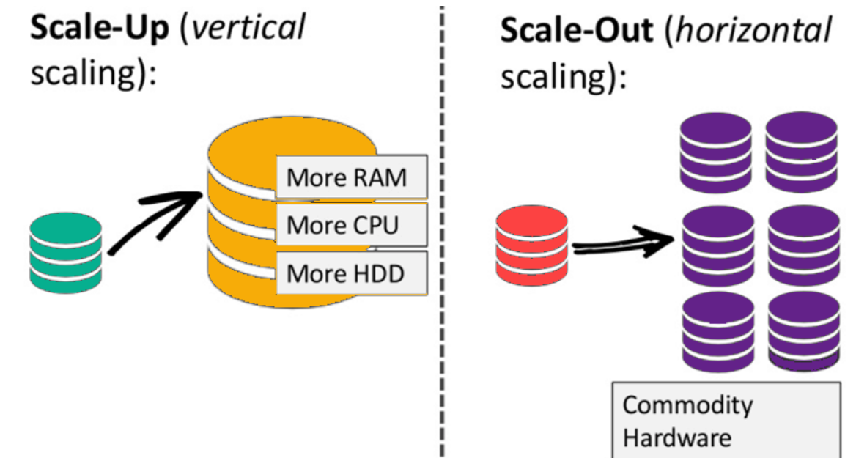
The Big Data Technology Landscape: No-SQL(Not Only SQL)
NoSQL database is non-relational, so it scales out better than relational databases as they are designed with web applications in mind.

Slide 25
Advantages of NoSQL
1. Can easily scale up and down: NoSQL database supports scaling rapidly and elastically and allows to scale to the cloud.
Cluster scale: It allows distribution of database across 100+ nodes often in multiple data centers,
Performance scale: It sustains over 100,000+ database reads and writes per second.
Data scale: It supports housing of 1 billion+ documents in the database,
2. Doesn't require a pre-defined schema: NoSQL does not require any adherence to pre-defined schema

Slide 26
Advantages of NoSQL
3. It is pretty flexible. For example, if we look at MongoDB, the documents in a collection can have different sets of key-value pairs.
4. Cheap, easy to implement: Deploying NoSQL. properly allows for all of the benefits : High availability, fault tolerance, etc, while also lowering operational costs.

Slide 27
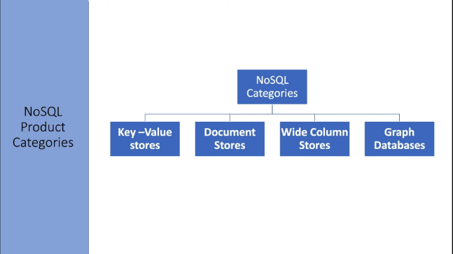
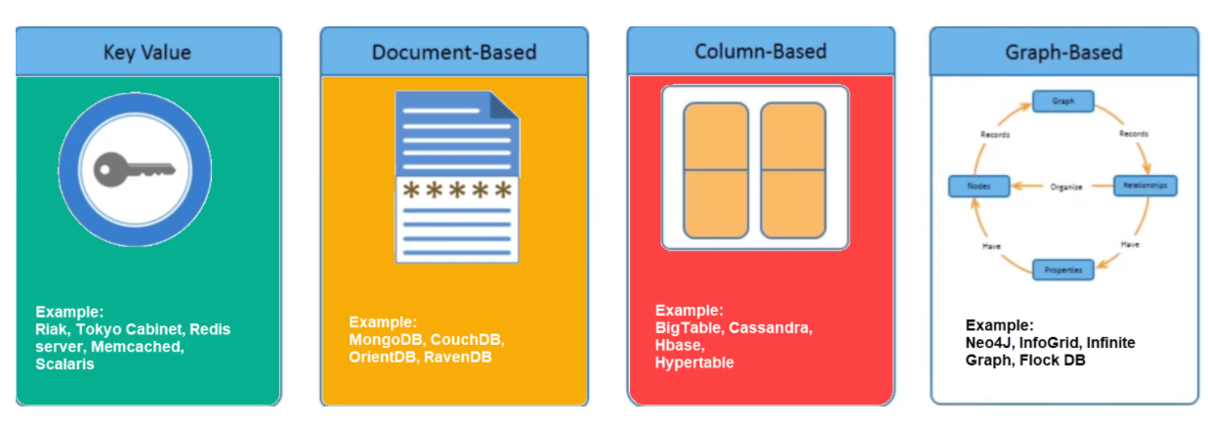
Types of NoSQL Databases
Key-value Pair Based
Column-oriented Graph
Graphs based
Document-oriented

Slide 28
Types of NoSQL Databases
Key Value Pair Based
Data is stored in key/value pairs. It is designed in such a way to handle lots of data and heavy load.
Key-value pair storage databases store data as a hash table where each key is unique, and the value can be a JSON, BLOB(Binary Large Objects), string, etc.
It is one of the most basic NoSQL database example. This kind of NoSQL database is used as a collection, dictionaries, associative arrays, etc. Key value stores help the developer to store schema-less data.
They work best for shopping cart contents.
Redis, Dynamo, Riak are some NoSQL examples of key-value store DataBases. They are all based on Amazon’s Dynamo paper.

Slide 29
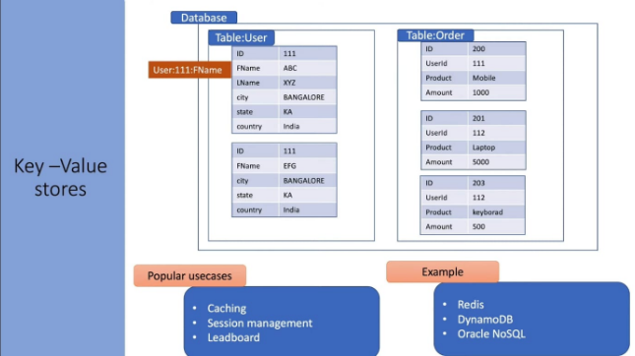
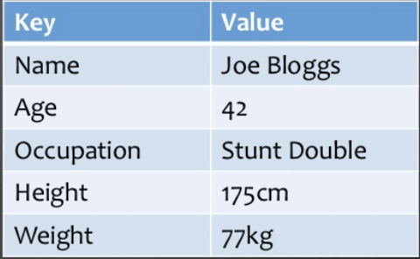
Types of NoSQL Databases
Key Value Pair Based

Slide 30
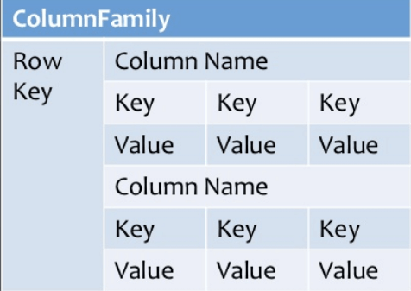
Column-based
Types of NoSQL Databases
Column-oriented databases work on columns and are based on Big Table paper by Google.
Every column is treated separately. Values of single column databases are stored contiguously.
They deliver high performance on aggregation queries like SUM, COUNT, AVG, MIN etc. as the data is readily available in a column.
Column-based NoSQL databases are widely used to manage data warehouses, business intelligence, CRM, Library card catalogs,
HBase, Cassandra, Hyper table are NoSQL query examples of column based database.

Slide 31
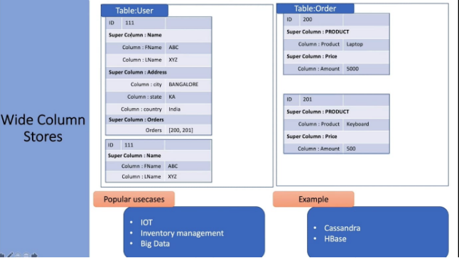

Slide 32
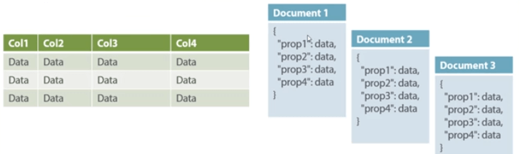
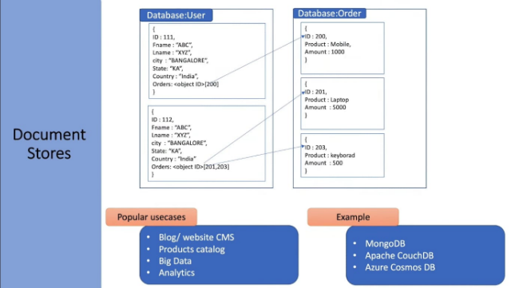
Document-Oriented:
Types of NoSQL Databases
Document-Oriented NoSQL DB stores and retrieves data as a key value pair but the value part is stored as a document.
The document is stored in JSON or XML formats.
The value is understood by the DB and can be queried.

Slide 33
Types of NoSQL Databases
Document-Oriented
In this diagram our left we can see we have rows and columns, and in the right, we have a document database which has a similar structure to JSON.
Now for the relational database, we have to know what columns we have and so on.
However, for a document database, we have data store like JSON object. We do not require to define which make it flexible.
The document type is mostly used for Content Management System(CMS systems), blogging platforms, real-time analytics & e-commerce applications.
It should not use for complex transactions which require multiple operations or queries against varying aggregate structures.
Amazon SimpleDB, CouchDB, MongoDB, Riak, Lotus Notes, MongoDB, are popular Document originated DBMS systems.

Slide 34
Graph-Based
Types of NoSQL Databases
A graph type database stores entities as well the relations amongst those entities.
The entity is stored as a node with the relationship as edges.
An edge gives a relationship between nodes.
Every node and edge has a unique identifier.
Compared to a relational database where tables are loosely connected, a Graph database is a multi-relational in nature.
Traversing relationship is fast as they are already captured into the DB, and there is no need to calculate them.
Graph base database mostly used for social networks, logistics, spatial data.
Neo4J, Infinite Graph, OrientDB, FlockDB are some popular graph-based databases.

Slide 35
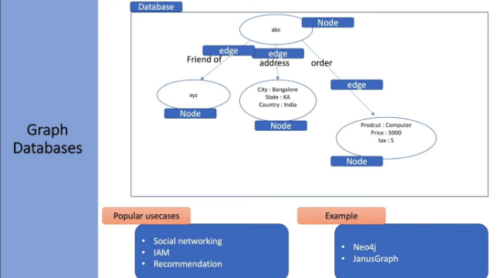
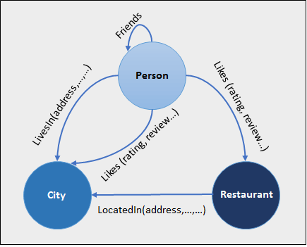
Types of NoSQL Databases
Graph-Based

Slide 36
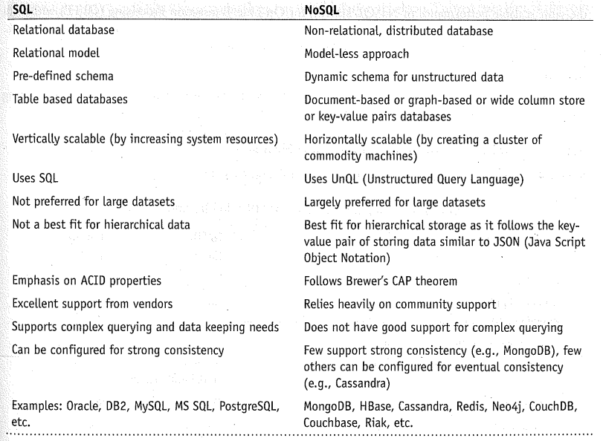
SQL versus NoSQL

